Slide 1
Real-Time Time-Optimal Reorientation of a Rigid Spacecraft
Author: Leonardo Eitner, M.Sc. candidate
Assistant Supervisor: Silvia Busi, PhD candidate
Head Supervisor: Prof. Dr. Marcello Romano
Context: Master’s Thesis

Slide 2
Objectives
1st
2nd
3rd
Compute the time-optimal trajectory for any attitude maneuver
Achieve computation times of less than 200ms
Reliably obtain solutions for different boundary conditions and spacraft configurations
min(maneuver_duration)
computation_time < 0.2 s
R_conv > 90%

Slide 3
Foundational Choices
Attitude
Parameterisation
Dynamics
Formulation
Optimisation
Methodology
Computational
Framework
NLP
Solver
Control
Parameterisation
BASELINE
ALGORITHM

Slide 4
Foundational Choices
Attitude
Parameterisation
Dynamics
Formulation
Optimisation
Methodology
Computational
Framework
NLP
Solver
Control
Parameterisation
Choice:
Quaternion parameterisation
Reasoning:
No singularities
Minimal redundancy
Linear kinematic equations
BASELINE
ALGORITHM

Slide 5
Foundational Choices
Attitude
Parameterisation
Dynamics
Formulation
Optimisation
Methodology
Computational
Framework
NLP
Solver
Control
Parameterisation
Choice:
Direct dynamics formulation
Reasoning:
Simpler implementation
Better handling of bang-bang control structure
Higher generality
BASELINE
ALGORITHM

Slide 6
Foundational Choices
Attitude
Parameterisation
Dynamics
Formulation
Optimisation
Methodology
Computational
Framework
NLP
Solver
Control
Parameterisation
Choice:
Full trajectory parameterisation
Reasoning:
Better convergence robustness
No assumption about solution structure
Higher generality
BASELINE
ALGORITHM

Slide 7
Foundational Choices
Attitude
Parameterisation
Dynamics
Formulation
Optimisation
Methodology
Computational
Framework
NLP
Solver
Control
Parameterisation
Choice:
Direct methods
Reasoning:
Less sensitive to initialisation
Less computationally expensive
Mature solver infrastructure
Intuitive initialisation
BASELINE
ALGORITHM

Slide 8
Foundational Choices
Attitude
Parameterisation
Dynamics
Formulation
Optimisation
Methodology
Computational
Framework
NLP
Solver
Control
Parameterisation
Choice:
CasADi
Reasoning:
Automatic differentiation
Automatic sparsity exploitation
C-code generation
High-level interface
Compatible with multiple NLP Solvers
BASELINE
ALGORITHM

Slide 9
Foundational Choices
Attitude
Parameterisation
Dynamics
Formulation
Optimisation
Methodology
Computational
Framework
NLP
Solver
Control
Parameterisation
Choice:
IPOPT
Reasoning:
General-purpose solver
Robust to bad initial guesses
Compatible with CasADi
Extensive literature validation
BASELINE
ALGORITHM

Slide 10
Algorithm Optimisation
BASELINE
ALGORITHM
Transcription Method
Multiple Shooting
VS
HS Collocation
Integration Scheme
CPU-RK4
VS
CVODES & GPU-RK4
NLP Solver
IPOPT
VS
FATROP
OPTIMISED
ALGORITHM

Slide 11
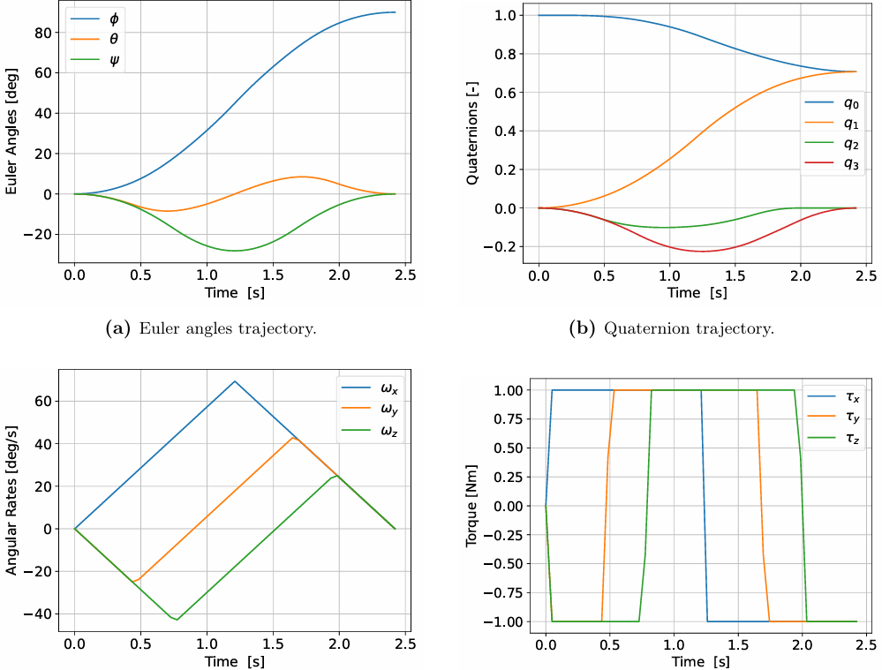
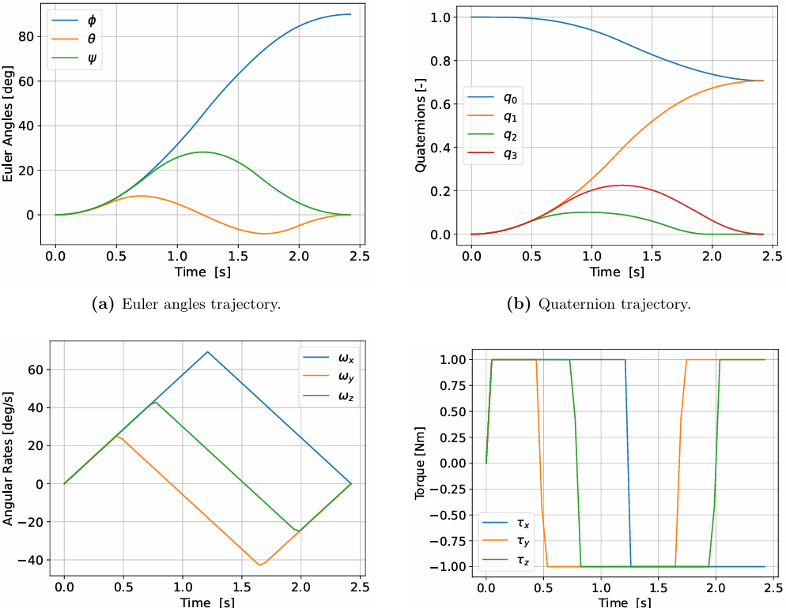
Algorithm Optimisation
Multiple Shooting
HS Collocation
Transcription Method
Multiple Shooting
VS
HS Collocation
 | Computation Time (s)
 | Multiple Shooting | HS Collocation
45° | 1.265 | 7.977
90° | 0.961 | 3.974
180° | 2.512 | 4.512
Integration Scheme
CPU-RK4
VS
CVODES & GPU-RK4
NLP Solver
IPOPT
VS
FATROP

Slide 12
Algorithm Optimisation
Transcription Method
Multiple Shooting
VS
HS Collocation
 | Computation Time (s)
 | CPU RK4 | GPU RK4 | GPU CVODES
45° | 15.890 | 18.129 | 852.945
90° | 2.147 | 59.575 | 3612.220
180° | 6.957 | 121.336 | 1559.010
Integration Scheme
CPU-RK4
VS
CVODES & GPU-RK4
NLP Solver
IPOPT
VS
FATROP

Slide 13
Algorithm Optimisation
Transcription Method
Multiple Shooting
VS
HS Collocation
 | Computation Time (s)
 | IPOPT | FATROP
45° | 1.265 | 0.085
90° | 0.961 | 0.107
180° | 2.512 | 0.191
Integration Scheme
CPU-RK4
VS
CVODES & GPU-RK4
NLP Solver
IPOPT
VS
FATROP

Slide 14
Reliability Analysis
CGPOPS
LGR
Collocation
IPOPT
BENCHMARK
ALGORITHM

Slide 15
Reliability Analysis
OPTIMISED
ALGORITHM
Results
LHS
Boundary Conditions
Compute
Performance
Metrics
BENCHMARK
ALGORITHM
Reference
Results
X 10,000

Slide 16
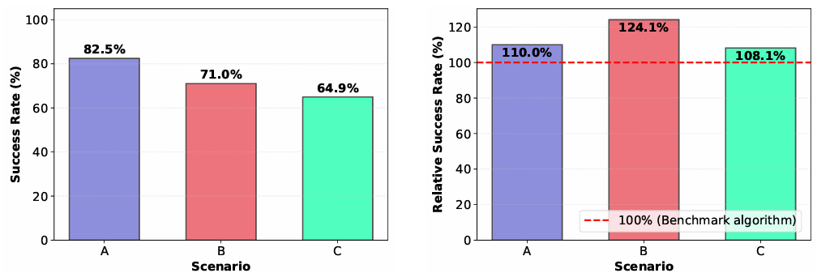
Reliability Analysis
Scenario A: Symmetric spacecraft | Rest-to-Rest
Scenario B: Symmetric spacecraft | Track-to-Track
Scenario C: Asymmetric spacecraft | Track-to-Track
91%
88%
70%
Benchmark
Optimised

Slide 17
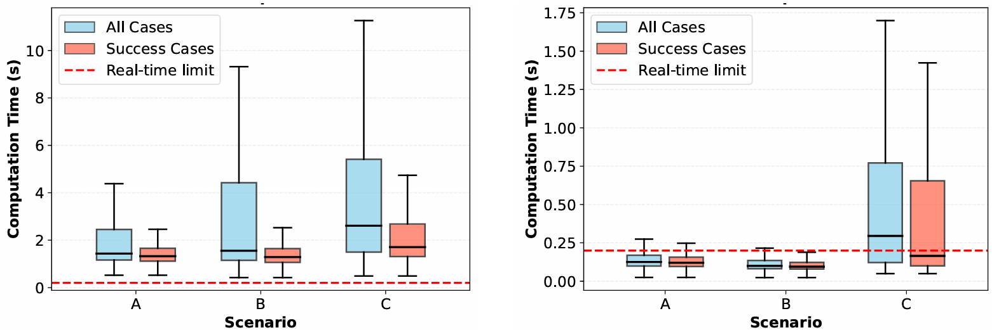
Reliability Analysis
Benchmark
Optimised

Slide 18
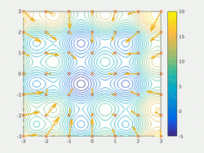


PSO Development
Update Law
$$v^{k+1}=w_{0}v^{k}+c_{1}r_{1}\left(p −x^{k}\right)+c_{2}r_{2}\left(g−x^{k}\right)$$
$$x^{k+1}=x^{k}+v^{k+1}$$
Legend:
$g$ → Global Best
$p$ → Personal Best
$v$ → Velocity
$x$ → Position
$w_{0}$ → Inertia weight
$c_{1}$ → Cognitive parameter
$c_{2}$ → Social parameter
$r_{1}$ → Random value
$r_{2}$ → Random Value

Slide 19
PSO Development
FULL
PSO
STO
PSO
Full control trajectory parameterisation
50 x 3 + 1 = 151 dimensions
No assumption about solution structure
Control switch times parameterisation
3 + 6 + 1 = 10 dimensions
Assumes bang-bang control

Slide 20

PSO Reliability
MC
Boundary
Conditions
LHS
PSO
Parameters
Compute
Performance
Metrics
X 1000

Slide 21
PSO Reliability
OPTIMISED
ALGORITHM
FULL
PSO
Initial
Guess
Results
LHS
Boundary Conditions
Compute
Performance
Metrics
OPTIMIZED
ALGORITHM
STO
PSO
Initial
Guess
Results
X 1000

Slide 22
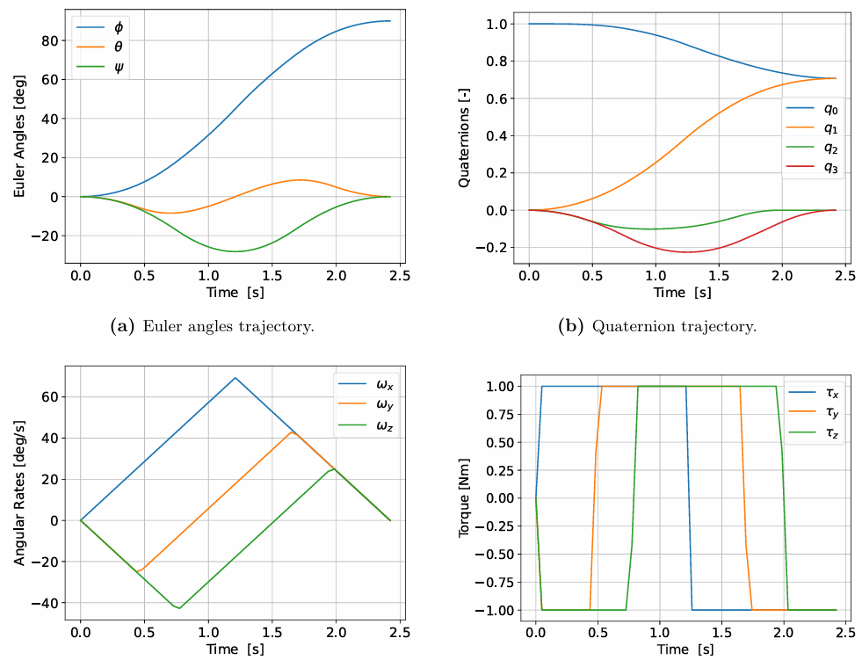
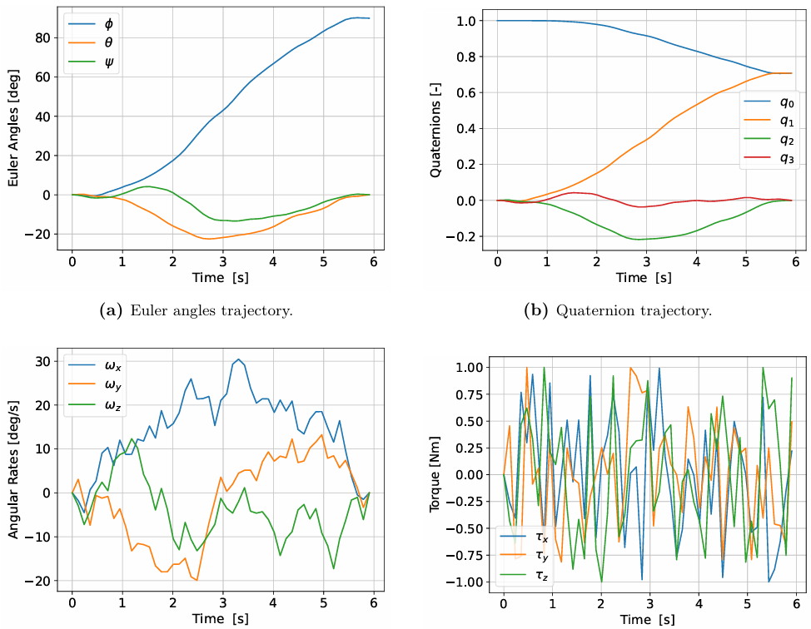
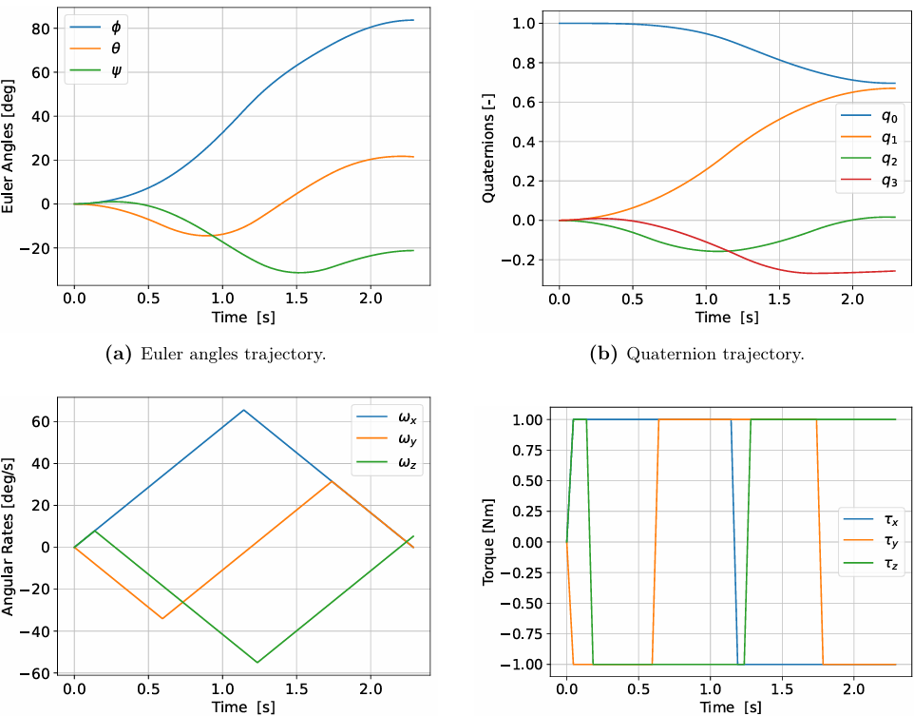
PSO Development
OPTIMAL
FULL PSO
STO PSO

Slide 23
PSO Reliability
OPTIMISED
ALGORITHM
FULL
PSO
Initial
Guess
Results
LHS
Boundary Conditions
Compute
Performance
Metrics
OPTIMIZED
ALGORITHM
STO
PSO
Initial
Guess
Results
X 10,000

Slide 24
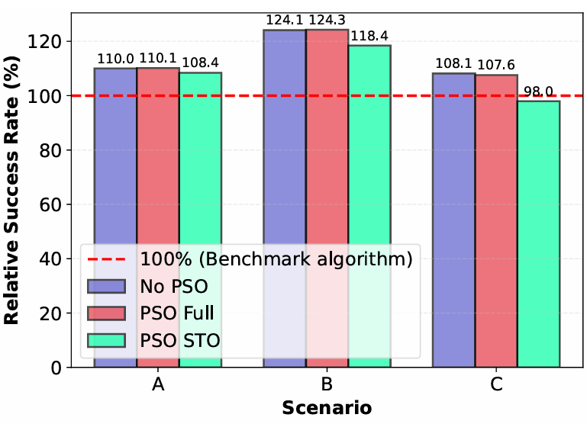
Reliability Analysis

Slide 25
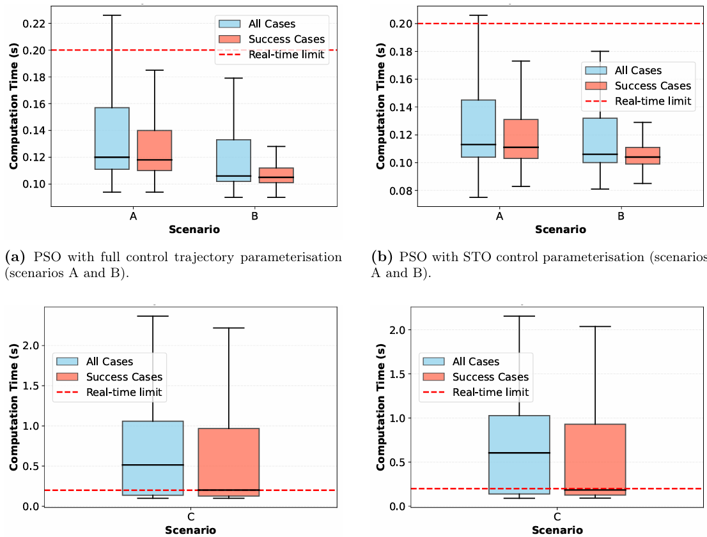
Reliability Analysis
PSO FULL
PSO STO
No PSO medians:
Scenario A: 125ms
Scenario B: 100ms
Scenario C: 295ms

Slide 26
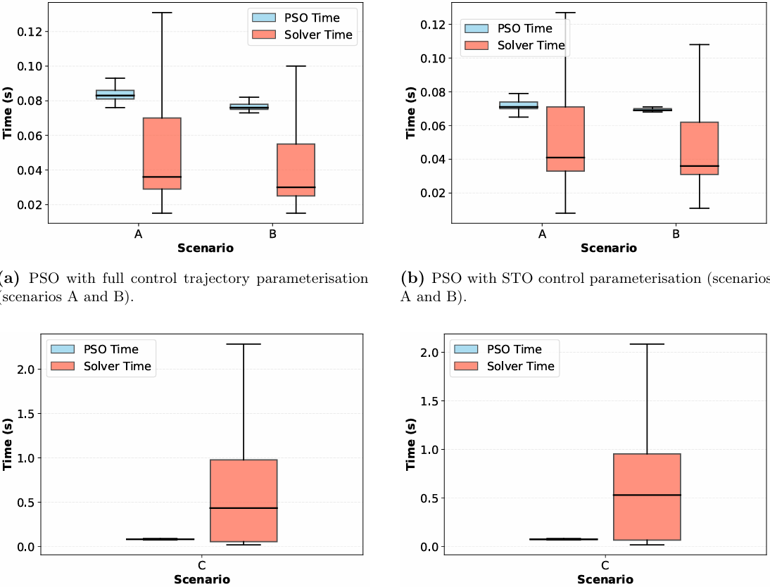
Reliability Analysis
PSO FULL
PSO STO
No PSO medians:
Scenario A: 125ms
Scenario B: 100ms
Scenario C: 295ms

Slide 27
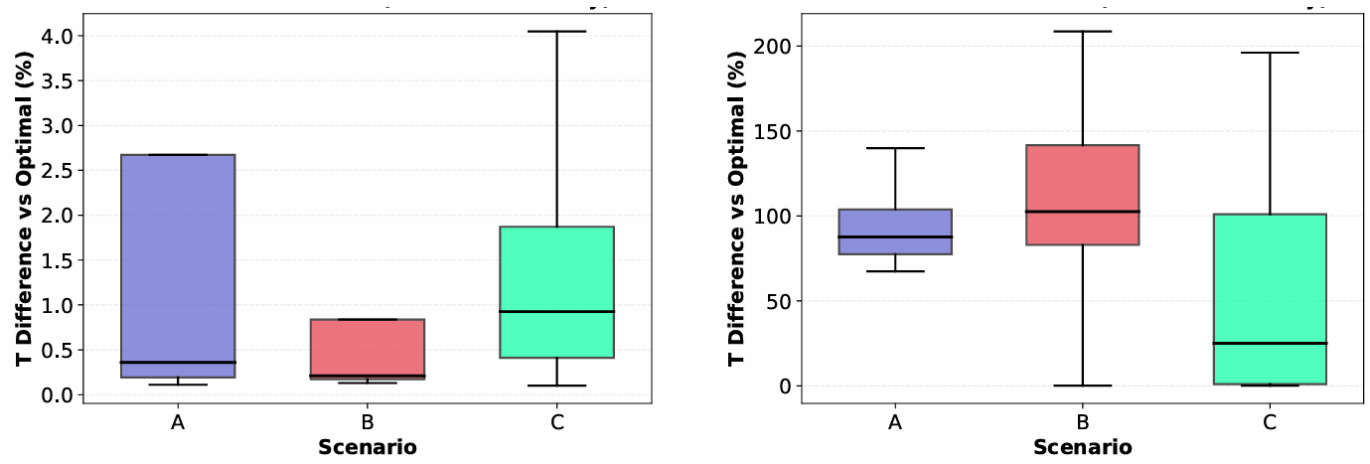

Reliability Analysis
$$\frac{abs\left(T_{CGPOPS}−T_{unconverged}\right)}{T_{CGPOPS}}×100$$
PSO FULL
PSO STO

Slide 28
Conclusion
 | Symmetric Spacecraft | Asymmetric Spacecraft
Computation Time | PSO STO (110ms) | No PSO (295ms)
Convergence Rate | PSO FULL (92%) | No PSO (70%)
Optimality Gap | PSO FULL (0.4%) | PSO FULL (0.9%)
Best Configuration | PSO FULL | No PSO

Slide 29
Conclusion
 | Symmetric Spacecraft | Asymmetric Spacecraft
Computation Time | PSO STO (110ms) | No PSO (295ms)
Convergence Rate | PSO FULL (92%) | No PSO (70%)
Optimality Gap | PSO FULL (0.4%) | PSO FULL (0.9%)
Best Configuration | PSO FULL | No PSO

Slide 30
Further Work
Incorporate flexible-body dynamics;
Add control-rate constraints to reflect actuator bandwidth limits;
Accept varying mass properties at runtime;
Develop configuration-specific and adaptive PSO tuning strategies;
Expand parameter search space beyond current 1000-case study;
Add path constraints such as keep-out cones
Hardware-in-the-loop validation

Slide 31
The End!
I am open to questions ☺

Slide 32
Algorithm Optimisation
GPU VS CPU Dynamics Propagation
  Result: CPU propagation was ~4x as fast as GPU
  Reason: Problem size is not significant to justify GPU utilization overhead (N_steps = 50)
  Conclusion: Propagate dynamics on CPU
Implicit VS Explicit Numerical Integration (CVODES VS RK4)
  Result: Although more robust, overhead from implicit integration is overwhelmingly greater
  Reason: CVODES is very heavy, even when used with CUDA
  Conclusion: Use RK4 as the numerical dynamics propagator
Fatrop vs IPOpt NLP gradient-based solvers
  Result: Fatrop is ~3x as fast as IPOpt
  Reason: Leverages problem sparsity better by being more restrictive with NLP structure
  Conclusion: Use Fatrop as the NLP gradient-based solver
CasADi automatic C-code generation VS C++
  Result: C++ was ~5x slower
  Reason: Compiled C-code is self-contained which reduces function calling overhead
  Conclusion: Generate C-code

Slide 33
Algorithm Optimisation
GPU VS CPU Dynamics Propagation
  Result: CPU propagation was ~4x as fast as GPU
  Reason: Problem size is not significant to justify GPU utilization overhead (N_steps = 50)
  Conclusion: Propagate dynamics on CPU
Implicit VS Explicit Numerical Integration (CVODES VS RK4)
  Result: Although more robust, overhead from implicit integration is overwhelmingly greater
  Reason: CVODES is very heavy, even when used with CUDA
  Conclusion: Use RK4 as the numerical dynamics propagator
Fatrop vs IPOpt NLP gradient-based solvers
  Result: Fatrop is ~3x as fast as IPOpt
  Reason: Leverages problem sparsity better by being more restrictive with NLP structure
  Conclusion: Use Fatrop as the NLP gradient-based solver
CasADi automatic C-code generation VS C++
  Result: C++ was ~5x slower
  Reason: Compiled C-code is self-contained which reduces function calling overhead
  Conclusion: Generate C-code

Slide 34
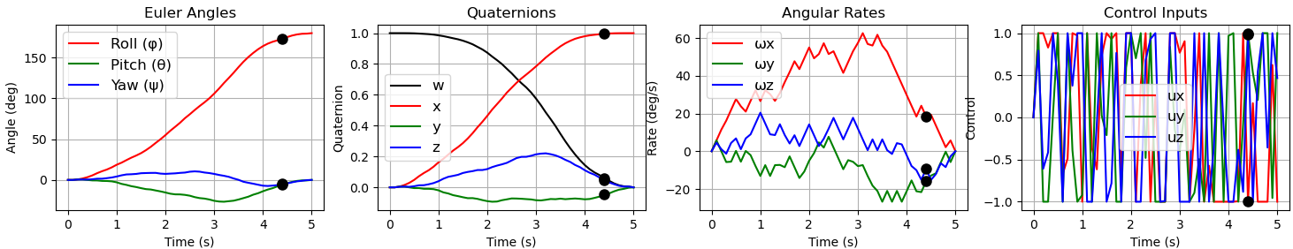
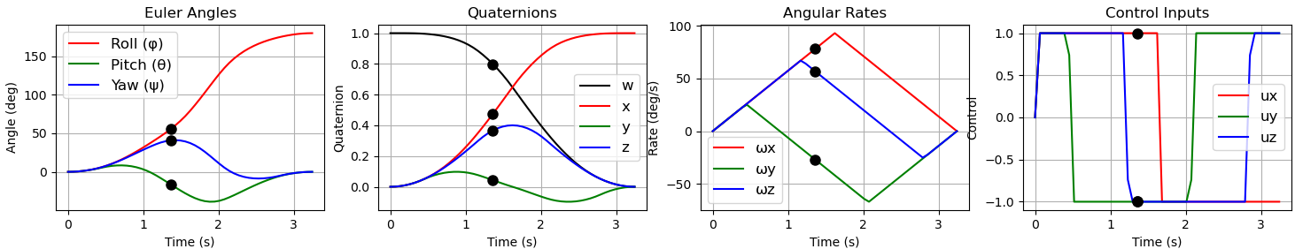
Results
PSO VS Fatrop NLP solvers
  PSO Results: (180 degree turn) Computation Time: 0.14s Maneuver Duration: 5s (3.24s)

Slide 35
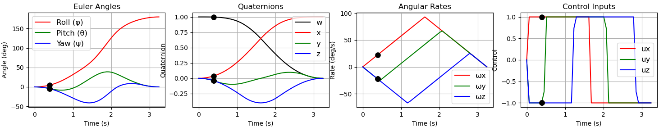
Results
PSO VS Fatrop NLP solvers
  Fatrop Results: (180 degree turn) Computation Time: 0.18s Maneuver Duration: 3.24s

Slide 36
Results
PSO + Fatrop VS only Fatrop NLP solvers
  Result: PSO + Fatrop finds a solution almost always faster as only fatrop.
  Reason: Fatrop finds a solution much faster with a good initial guess
  Conclusion: PSO + Fatrop seems to be the most optimal solver configuration
 |  | Computation Time (s) |  |  | Maneuver Duration (s)
 |  | Total | Fatrop | PSO
Close to fixed initial guess | PSO + Fatrop | 0.16 | 0.016 | 0.15 | 3.24
 | Only Fatrop | 0.12s | 0.12 | - | 3.24
Very different from fixed initial guess | PSO + Fatrop | 0.2 | 0.03 | 0.17 | 3.44
 | Only Fatrop | 0.58 | 0.58 | - | 3.50

Slide 37

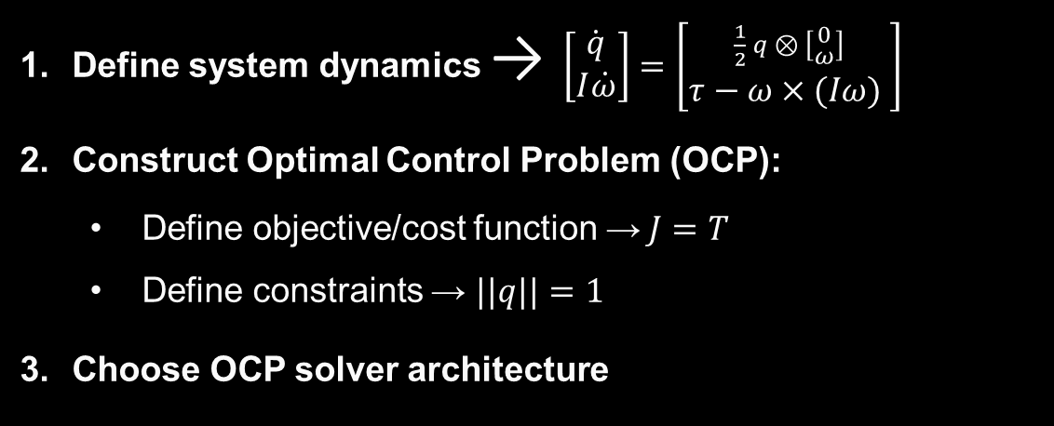
Methodology
Define system dynamics → $\left[\dot{\begin{aligned}q \\ I\dot{ω}\end{aligned}}\right]=\left[\begin{aligned}\frac{1}{2} q ⊗ \left[\begin{aligned}0 \\ ω\end{aligned}\right] \\ τ−ω×(Iω) \end{aligned}\right]$
Construct Optimal Control Problem (OCP):
  Define objective/cost function →$J=T$
  Define constraints → $||q||=1$
Choose OCP solver architecture
1st
Compute the time-optimal trajectory for any attitude maneuver
Legend:
$q$ → Quaternion vector
$ω$ → Angular velocity vector
$I$ → Inertia matrix
$τ$ → External torque vector
$J$ → Cost function
$T$ → Total maneuver duration
$⊗$ → Quaternion multiplication
$×$ → Cross product
$\dot{∎}$ → Time derivative
||$∎$|| → Euclidean norm
min(maneuver_duration)

Slide 38
Foundational Choices
Choose OCP solver architecture
  Solving methods:
2nd
Robustly obtain solutions in less than 1 second
 | Direct | Indirect
Approach | Discretize → Optimize | Derive optimality conditions → Discretize
Robustness | Can converge even with bad initial guess | Sensitive to initial guess
Implementation | Easier | More complex
Optimality | Approximate solution | Potentially exact
Solve speed | Real-time capable | Slow
computation_time < 1 s

Slide 39
Methodology
Choose OCP solver architecture
  Solving methods:
2nd
Robustly obtain solutions in less than 1 second
 | Direct | Indirect
Approach | Discretize → Optimize | Derive optimality conditions → Discretize
Robustness | Can converge even with bad initial guess | Sensitive to initial guess
Implementation | Easier | More complex
Optimality | Approximate solution | Potentially exact
Solve speed | Real-time capable | Slow
computation_time < 1 s

Slide 40
Methodology
Choose OCP solver architecture
  Direct transcription methods:
2nd
Robustly obtain solutions in less than 1 second
 | Shooting |  | Collocation
 | Single | Multiple | Direct | Pseudospectral
Dynamics Handling | Forward integration | Segmented integration | Algebraic constraints | Dense global polynomial
Accuracy | Integrator-limited | Integrator-limited | Grid density dependent | Exponential (smooth problems)
Problem Size | Smallest | Medium | Large | Large
Complexity | Simplest | Moderate | Moderate-High | Highest
Robustness | Poor | Moderate | Good | Poor (non-smooth)
Real-time Suitability | Fast but unreliable | Good balance | Solver dependent | Generally slow
computation_time < 1 s

Slide 41

Implementation
  Framework: CasADi
    Open-source
    Automatic differentiation
    Simple NLP interface
    Automatic c-code generation
    Source-code in c++
    Extensive NLP solver compatibility

Slide 42
Implementation
  NLP Solvers:
 | Interior Point | SQP Methods | SCP Methods
Warm-starting | Poor | Excellent | Good
Convergence Rate | Superlinear | Superlinear | Linear to superlinear
Problem Scale | Large-scale optimal | Medium-scale optimal | Medium-scale
Robustness | Very good | Good | Moderate
Real-time Suitability | Solver dependent | Excellent | Good
Trajectory Optimization | General purpose | General purpose | Specialized strength
Example | IPOPT, Fatrop | QRSQP, SNOPT | SCPGen

Slide 43
Implementation
  Initial guess:
    Single general initial guess
    Initial guess library
    Initial guess algorithm - PSO
A particle swarm searching for the global minimum of a function

Slide 44
What‘s Next?
?
Implement and test direct collocation
Experiment with different solvers
Create a Monte Carlo simulation for robustness testing

